Slide 1


ModAR
modAR
Revolutionizing the way
of teaching
-By Team Inferno
Revolutionizing the way of teaching
Team Inferno

Slide 2

Content
Problem Statement
Solution
Use Case
Tech Stack
Design of the prototype

Slide 3

Problem Statement
The current online education system needs a change to revive the enthusiasm among students for attending lectures.
Teachers present their material or textbooks to teach, which inevitably becomes a yawn fest for students.
Various topics of Science cannot be given justice by observing diagrams on paper.
Imagination is a key element in the learning process of children, which particularly is lacking in the current teaching format.

Slide 4
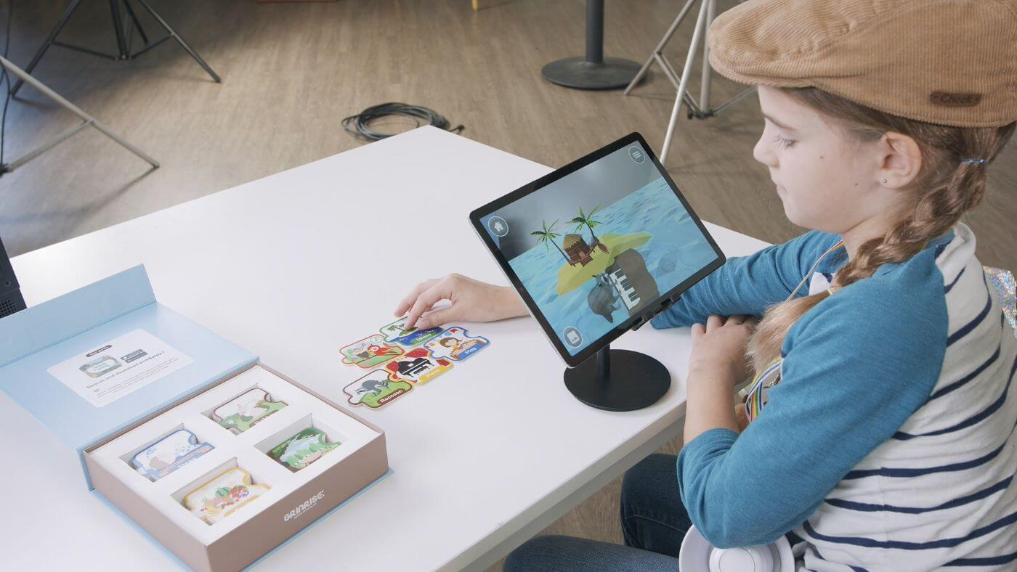
Solution
We propose a prototype of an Augmented Reality based system wherein school students would be able to observe 3D models of various subjects.
We aim to make a website having 3 topics: human anatomy, solar system and English alphabets.
On selecting any one of the topics, the website would display images and relevant information of various subtopics.
These images can be scanned by our custom mobile application which would immediately augment a 3D model of those images.
These models can be observed from any angle by rotating our phone and the information provided by the website would aid in better understanding of the same.

Slide 5
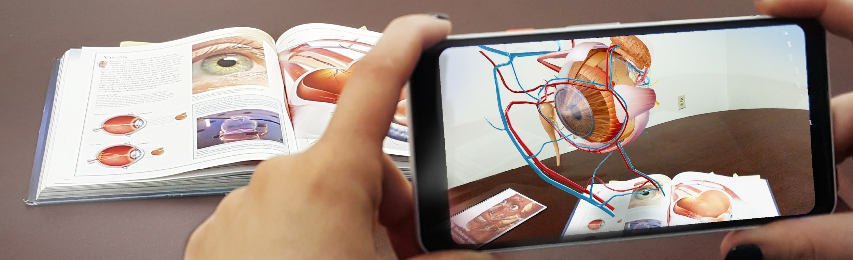
Use Case
Kindergarten kids would be fascinated to see pictures coming alive and instead of hammering “A for apple” ,it would fit in their mind permanently.
Human anatomy becomes difficult to comprehend by looking at diagrams in textbooks having numerous labels. A 3D model however would make the subject more enjoyable and easily understandable.
Visualization of solar system would help students understand how exactly the rotation of planets takes place instead of explaining it with a plain diagram.
Similar concept can also be used in mechanical engineering or architecture where simulation would prove to be more beneficial than just theory.

Slide 6





Tech Stack

Slide 7
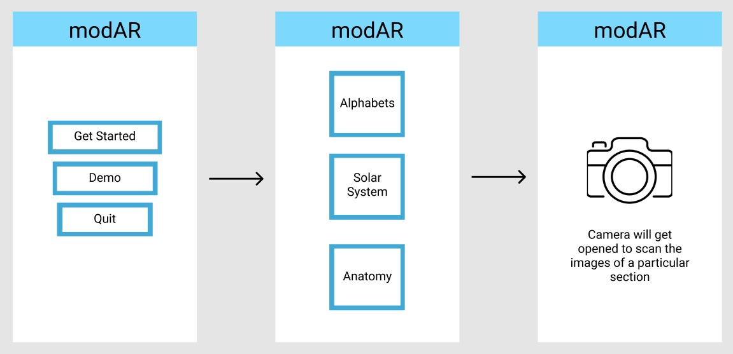
Wireframe of the Mobile App

Slide 8
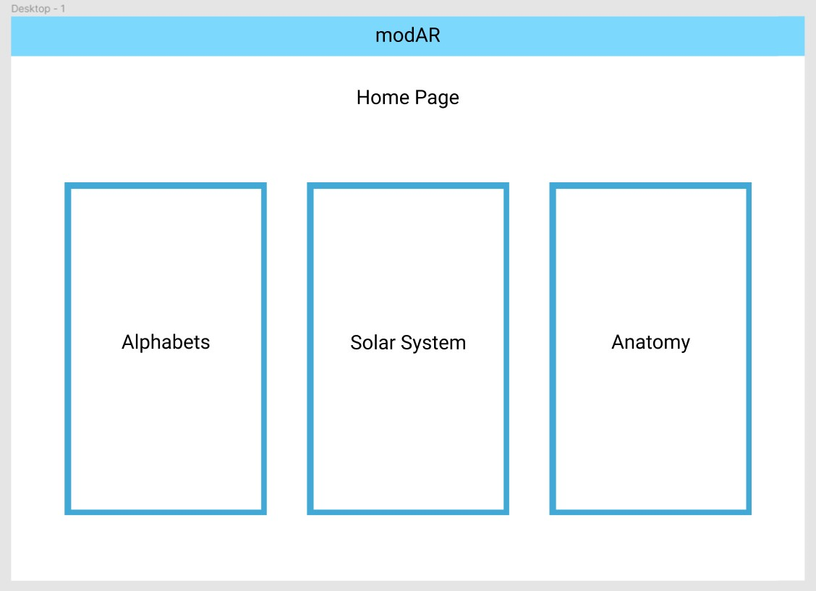
Wireframe of the website

Slide 9
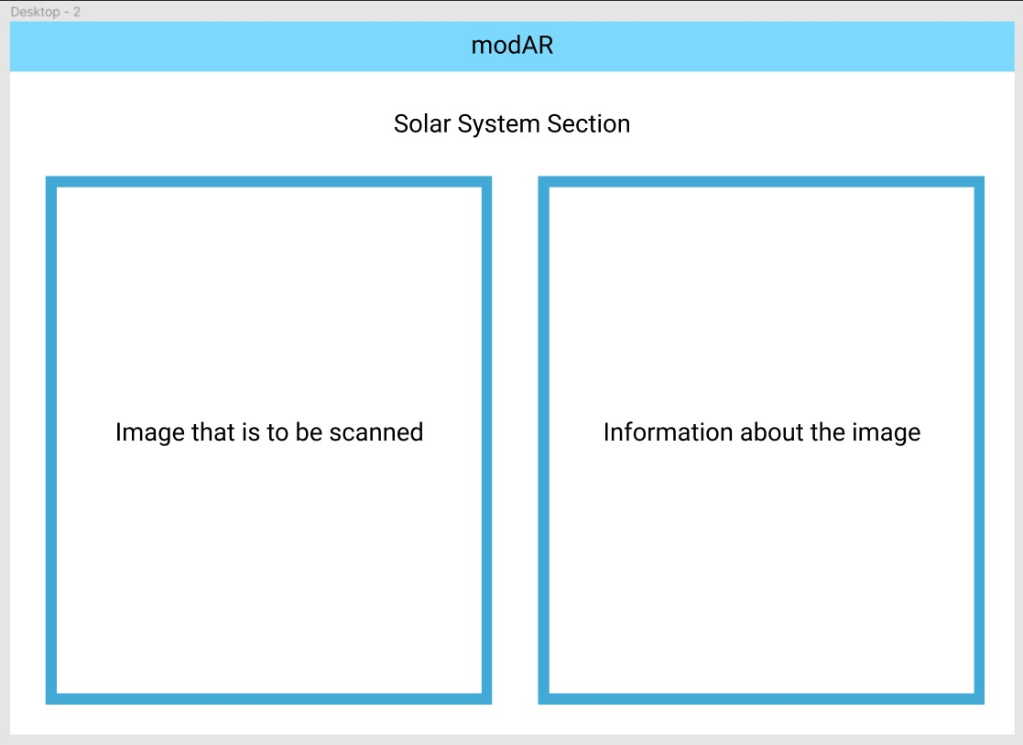
Wireframe of the website

Slide 10

Wireframe of the website
Thank You

